Slide 1
Unpaid Work and Work Participation of Women: Insights from India’s Time Use Data
Author: Surajit Deb
(University of Delhi)
Presenter: Sabrina Wulff Pabilonia
(U.S. Bureau of Labor Statistics)
IARIW 2021 General Conference
August 24, 2021

Slide 2
Motivation and Background
Indian women’s labor force participation rate is low (22% in 2018-19)
  Lack of job growth in formal sectors, especially in rural areas
  Social norms
  A gender gap in education
  Lack of safety
  Family and caregiving responsibilities

Slide 3
Paper Goals
Use time use data to highlight the paid and unpaid work of men and women across India’s states (SNA/non-SNA work)
  Rural/urban differences
Test whether unpaid work crowds out paid work for women
Test whether the Periodic Labor Force Survey captures paid work activities using time diary data

Slide 4
2019 Time Use Survey
First full-scale time use survey across India’s 30 states
  1998-99 time use survey covered only 6 states
January – December
138,799 households and 447,250 persons
  Time diaries for all household members aged 6+
  This project uses diaries for persons aged 15–59
Time diary covers a 24-hour-period beginning at 4:00 A.M. on the day before the interview and ending at 4:00 A.M. on the day of the interview. (short recall)
Asked about primary and secondary activities for 9 different time use categories

Slide 5
Time Use Categories
(Based on International Classification of Activities for Time Use Statistics 2016)
Employment and related activities
Production of goods for own final use
Unpaid domestic services for household members
Unpaid caregiving services for household members
Unpaid volunteer, trainee and other unpaid work
Learning
Socializing and communication, community participation and religious practice
Culture, leisure, mass-media and sports practices
Self-care and maintenance

Slide 6
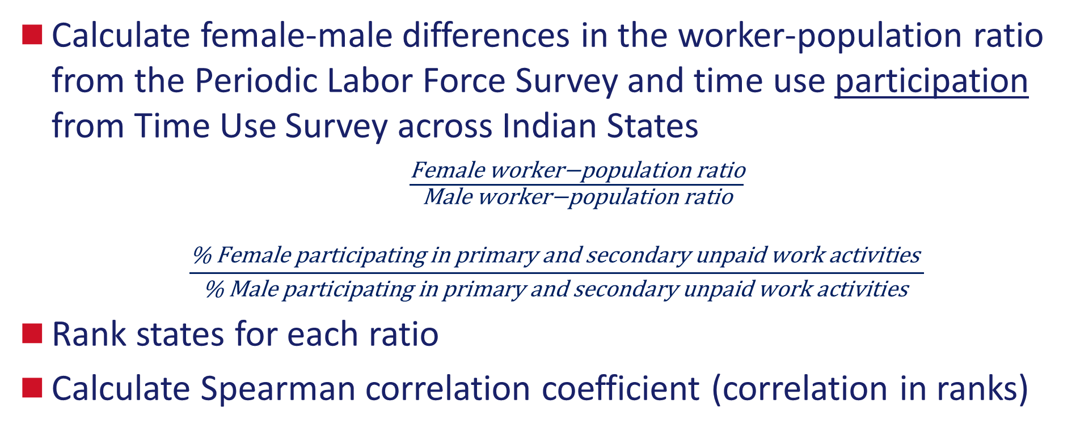
Method
Calculate female-male differences in the worker-population ratio from the Periodic Labor Force Survey and time use participation from Time Use Survey across Indian States
$\frac{\text{Female} \text{w}\text{orker}\text{−}\text{population} \text{ratio}}{\text{M}\text{ale} \text{w}\text{orker}\text{−}\text{population} \text{ratio}}$
        $$\frac{\text{\% }\text{Female} \text{participating} \text{in} \text{primary} \text{and} \text{secondary} \text{un}\text{paid} \text{work} \text{activities} }{\text{\% }\text{Male} \text{participating} \text{in} \text{primary} \text{and} \text{secondary} \text{unpaid} \text{work} \text{activities} }$$
Rank states for each ratio
Calculate Spearman correlation coefficient (correlation in ranks)

Slide 9
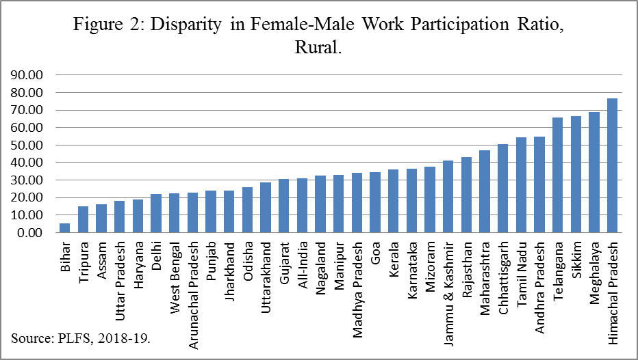
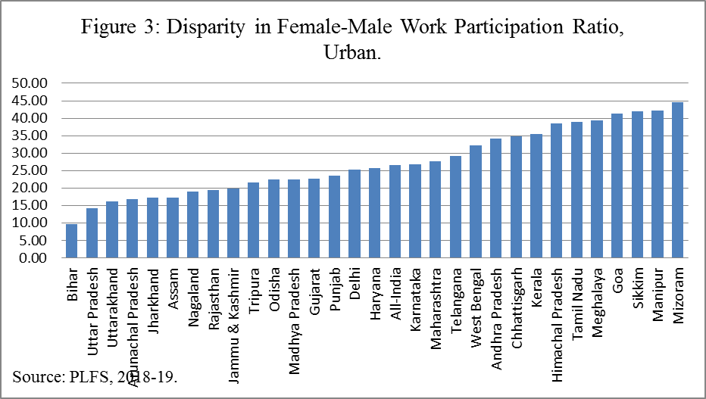

Slide 10
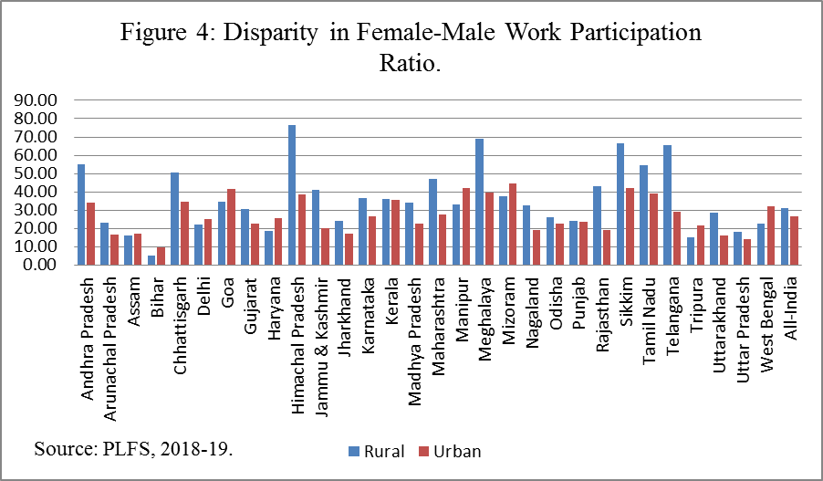

Slide 11
Paid and Unpaid Work Participation
Paid work
  Self-employment
  Wage and salary work
  Casual labor
Unpaid work
  Care for persons in own households
  Production for own consumption
  Voluntary work for production of goods and services in households
  Voluntary work for production of goods and service in market/non-market units
  Unpaid trainee work/Other unpaid work

Slide 12
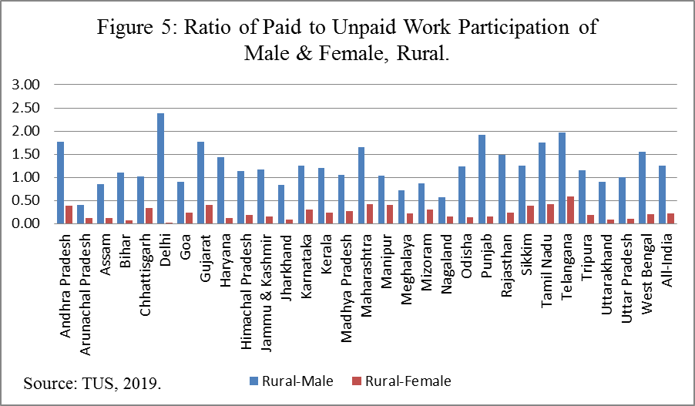
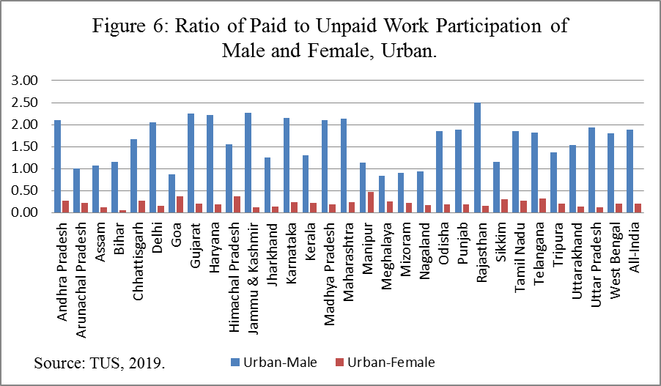

Slide 13
SNA production activities:
  Employment in corporations, government and non-profit institutions
  Production of goods for own final use
  Employment in household enterprises to produce goods
  Employment in household enterprises to provide services
  Ancillary activities and breaks related to employment
  Training and studies in relation to employment
  Employment-related travel
  Unpaid trainee work and related activities
  Unpaid direct volunteering for other households for production of goods or for production of goods/services for market/non-market units
  Unpaid community- and organization-based volunteering for production of goods or for production of goods/services for market/non-market units
  Other unpaid work activities (other than those which are already covered in SNA or covered in non-SNA production)
  Non-SNA production:
  Unpaid domestic services for household members
  Unpaid caregiving services for household members
  Unpaid direct volunteering for other households for production of services for the households
  Unpaid community- and organization-based volunteering for production of services for the households

Slide 14
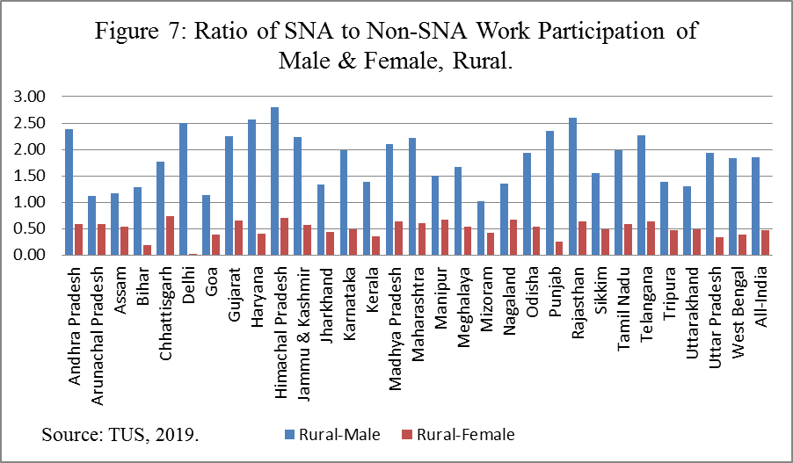
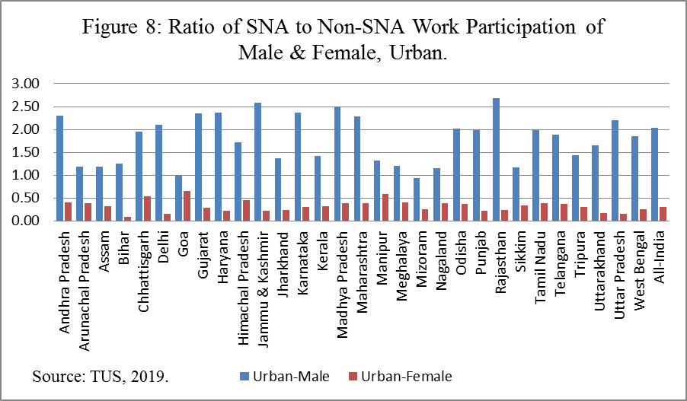

Slide 15
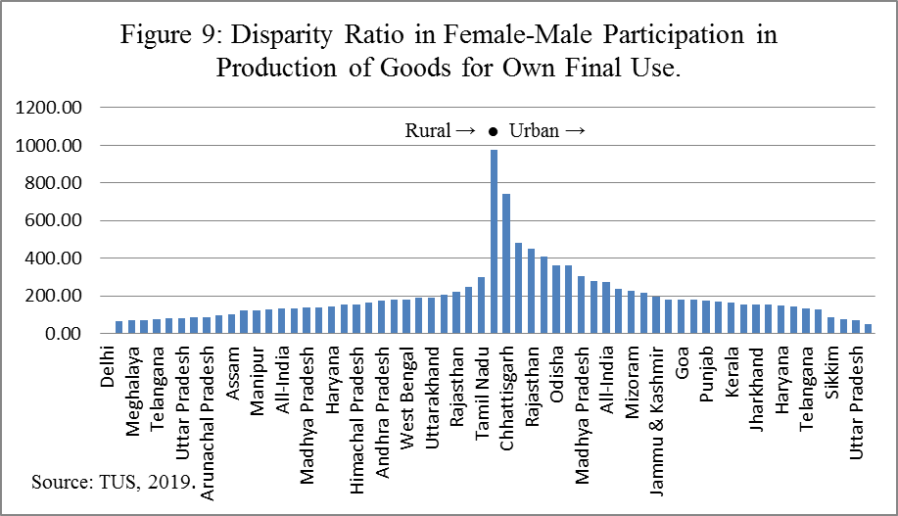

Slide 16
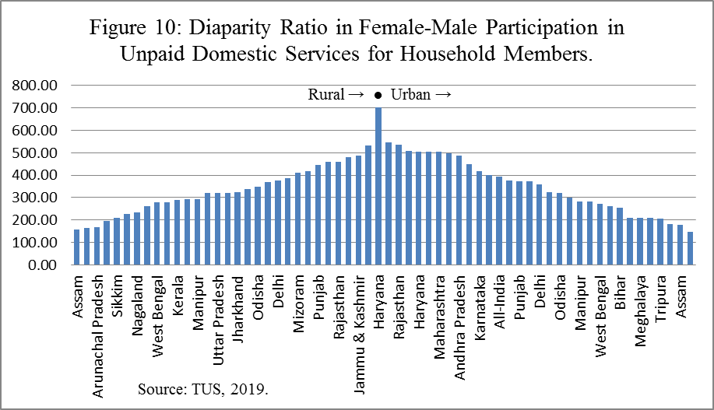

Slide 17
Table 1: Spearman’s Rank Correlation Coefficient of Female-Male Disparity
Ratio in Worker Population Ratio and Participation in Different Time-Use Activities
Correlation of Disparity in Female-Male Worker Population Ratio with: | Disparity in Female Male Participation in Employment and Related Activities | Disparity in Female Male Participation in Production of Goods for Own Final Use | Disparity in Female Male Participation in Unpaid Domestic Services for Households
Rural | 0.70 | 0.06 | 0.32
Urban | 0.81 | 0.12 | -0.04
Total | 0.76 | 0.11 | 0.27
The formula used for Spearman’s Rank Correlation is r = [1- (6∑ d²/n³ – n)].

Slide 18
Conclusion
There is huge variation in female-male paid work (especially in urban areas) and unpaid work activities across Indian states.
Correlations between the state rankings in the Female-Male Worker Population Ratio and participation in employment activities are high, suggesting the surveys are capturing similar disparities in paid work.
No evidence of a tradeoff between labor force participation and unpaid activities, at least in terms of participation.

Slide 19
Next Steps
Calculate correlation coefficient between paid and unpaid activities in time use survey to look at the trade-off (same 24-hour reference period)
Define participation as positive if do the work activity for at least one hour (ILO, “Resolution on Statistics on Work, Employment, and Labour Underutilization” 2013, #21)
Add more details about the time use survey to the paper

Slide 20
Next Steps
Instead of participation, calculate the average time spent in major activities for all persons
  What is the total daily work burden (“time poverty”) for women across states?
  Are there differences in leisure time across states?
Informal sector
  Does the time use survey pick up work in this sector that is not picked up in the Periodic Labor Force Survey?
  More context in text for the prevalence of this sector by state and by urbanicity
  Can women easily combine paid and unpaid activities (multitasking)?

Slide 21
Sabrina Wulff Pabilonia
Office of Productivity and Technology
Bureau of Labor Statistics
www.bls.gov/dpr
202-691-5614
Pabilonia.Sabrina@bls.gov

