Slide 1

Big Data for 21st Century Economic Statistics
Katharine G. Abraham, University of Maryland
Ruggles Lecture
August 23, 2021

Slide 2
Infrastructure and methods for U.S. economic statistics developed in years after WWII
For decades, surveys based on probability samples have provided reliable estimates at lower cost than complete enumerations
  Surveys underlie estimates of employment, unemployment, earnings, labor turnover, job openings, production, sales, prices, …
  Samples designed to represent the population of interest
  Questionnaires designed to collect desired information
Periodic censuses and administrative data provide benchmarks
Tasks allocated across several statistical agencies
  Bureau of Labor Statistics (BLS), U.S. Census Bureau and Bureau of Economic Analysis (BEA) primary responsibility for economic data

Slide 3
Model has served nation well, but subject to growing pressures
Increasing difficulty of obtaining survey responses

Slide 4
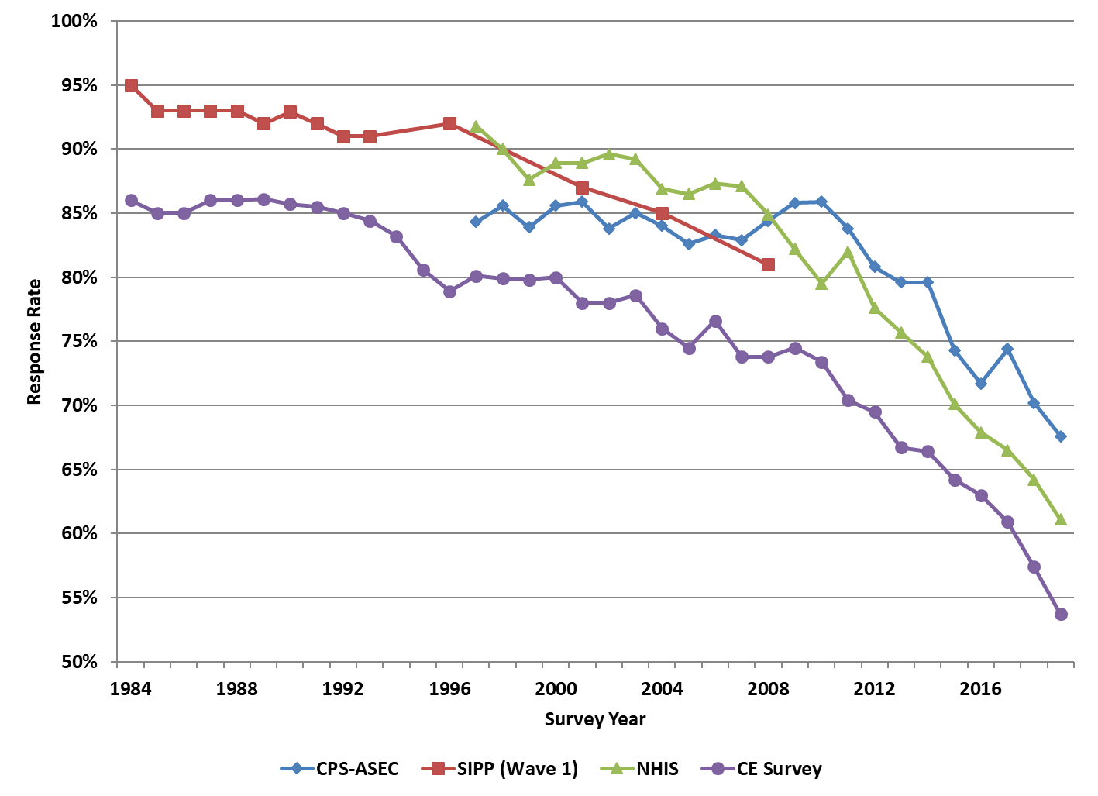
Unit response rates, selected household surveys
Source: Meyer, Mok and Sullivan (2015), adapted and updated

Slide 5
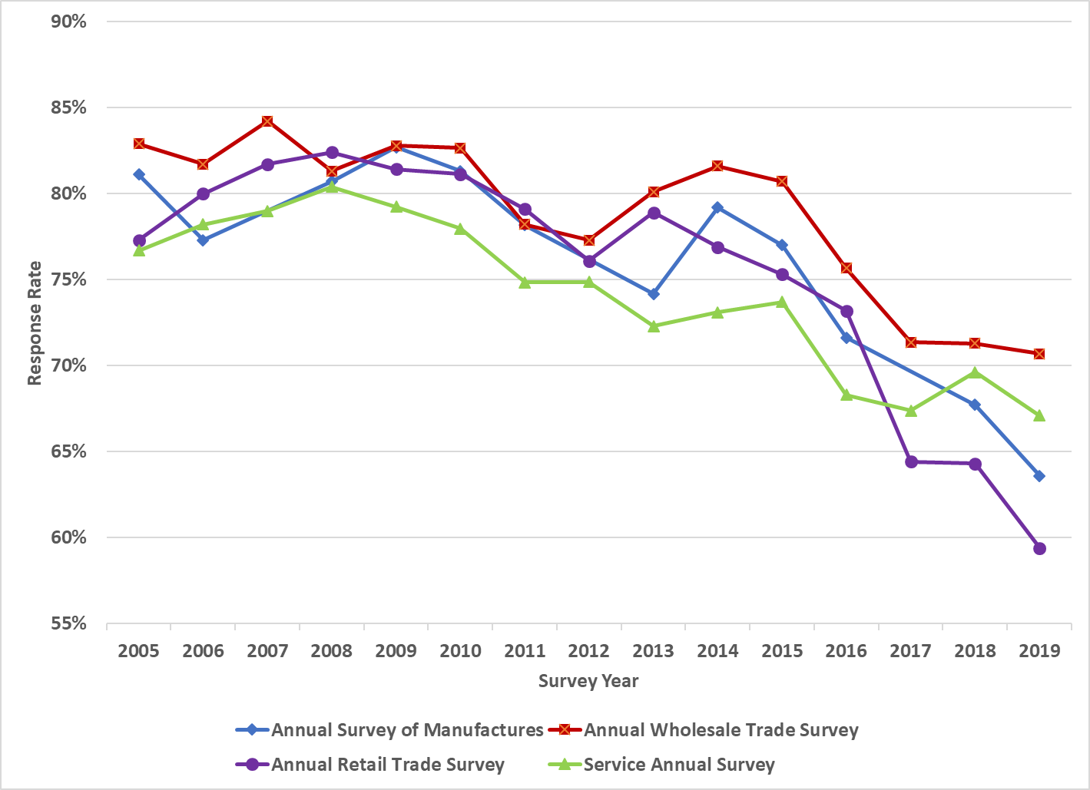
Unit response rates, selected annual business surveys
Source: U.S. Census Bureau

Slide 6
Model has served nation well, but subject to growing pressures
Increasing difficulty of obtaining survey responses
Increasing demand for more timely data

Slide 7
Model has served nation well, but subject to growing pressures
Increasing difficulty of obtaining survey responses
Increasing demand for more timely data
Increasing demand for more disaggregated data

Slide 8
Model has served nation well, but subject to growing pressures
Increasing difficulty of obtaining survey responses
Increasing demand for more timely data
Increasing demand for more disaggregated data
Stagnant or declining agency budgets

Slide 9
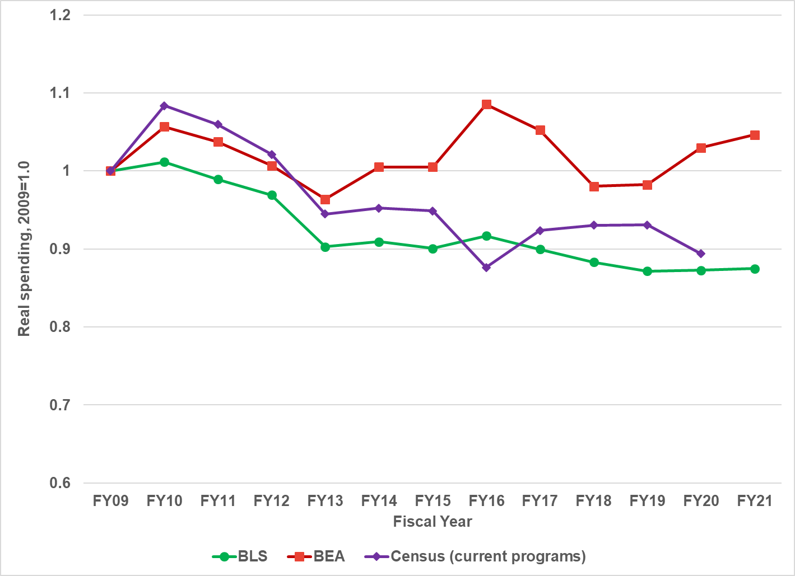
Economic statistics agency real funding trends (2009=1)
Source: American Statistical Association; Statistical Programs of the U.S. Government, various years

Slide 10
Big data to the rescue?
Natively digital data have proliferated in recent years
Economic statistics agencies considerable experience with administrative big data
New frontier: Use of naturally occurring data from private sources in the production of economic statistics to:
  Reduce respondent burden
  Increase timeliness and/or reduce revisions of published data
  Increase the granularity of published data
  Lower statistical agency costs?

Slide 11
Wealth of naturally occurring private data
Scanner data from retail outlets
Prices, product characteristics and other information on the Web
Credit card transactions data (e.g., JP Morgan Chase data, Spending Pulse MasterCard data)
Payroll processing and scheduling data
Sensor data (e.g., satellite imaging, traffic cameras)
GPS tracking data (e.g., tractors, trucks)

Slide 12
Considerations in incorporating naturally occurring data into official statistics
Survey data
Small but representative share of target population observed directly
Data elements selected to meet statistical needs
Quality control central to survey process, though errors in measurement may arise
Naturally occurring data
Large but not necessarily representative convenience samples
Data elements reflect needs and constraints of business processes
Data elements relevant to business processes most likely to be accurate

Slide 13
Considerations in incorporating naturally occurring data into official statistics (continued)
Survey data
Comparability of data over time controlled by survey statistician
Data records designed for statistical analysis; typically well documented
Data “owned” by statistical agency, typically collected from respondents under a pledge of confidentiality
Naturally occurring data
Comparability of data over time may be disrupted by changes in business requirements
Data records reflect business purposes; may or may not be well documented
Data “owned” by business where it was generated; obtaining data may be expensive or raise legal, business or other concerns (including concerns about relying on a monopoly provider)

Slide 14
Considerations in incorporating naturally occurring data into official statistics (continued)
Survey data
Agencies’ physical and human infrastructure developed for collection and processing of survey data
Naturally occurring data
Naturally occurring data sets require enhancements to computing capacity and additional staff skills

Slide 15
Potential criteria for deciding when to adopt big data for official statistics
Collecting data using current methods has become difficult or is proving inadequate to meet users’ demands
Alternative data a good fit for the intended purpose
Quality of estimates of similar or better quality
Costs are lower or added cost can be justified based on improvements to estimates
Risk of relying on 3rd-party data suppliers can be mitigated

Slide 16
BLS: Using big data to improve the Consumer Price Index (CPI)
CPI price data collected by surveying businesses and rental units
  Commodities and Services Survey: ~94,000 prices per month
  Housing Survey: ~8,000 rental housing unit quotes per month
  Majority of data collected by personal visit
Program underway to substitute data from alternative sources where feasible and cost-effective
  Similar programs underway at ONS and Statistics Canada

Slide 17
Source: Paplomatas (2021)

Slide 18
BEA: Using big data to improve early GDP estimates
GDP “advance” estimates released one month after end of quarter
  Data from Census Quarterly Services Survey (QSS) not yet available
  Estimated services spending for that release extrapolated from past data
BEA researchers explored methods for “nowcasting” QSS estimates
  Tested models based on different algorithms and different predictor variables
  y_{it} quarterly growth in industry i, f_{m} algorithm, and g_{k} variable selection operator
  Candidate X’s include traditional data (employment, prices) and nontraditional data (credit card transactions, Google search queries)
$$\left.y_{it}=f_{m}[g_{k}\left(X_{t}, Y_{i,t−p}\right)\right]$$

Slide 19
BEA: Using big data to improve early GDP estimates (continued)
Goal: Reduce revisions between advance and 3rd estimates
  Greatest reductions: Ensemble models using employment, credit card data
  Significant improvements in predictions for a number of sectors
Nowcasting has been incorporated into GDP production process
  Most often used for health care services and software investment

Slide 20
Census Bureau: Using big data to produce state-level retail sales estimates
Monthly retail sales data collected from a survey sample of ~13,000 retail and food services businesses
  Data collected at company level; no geographic component to design
Census has explored use of point-of-sale data from 3rd party vendor NPD to reduce respondent burden and improve national estimates
NPD data key input to new experimental monthly state-level estimates
  Estimates for total retail excluding non-store retailers, 11 specific sectors
  Top-down estimates: National sales allocated based on share of industry’s annual payroll in each state
  Bottom-up estimates: Sum of sales for pre-selected multi-unit businesses from NPD, survey reporters operating in a single state, and imputed values for other retailers
  Composite estimates: Weighted sum of two estimates; weights based on relative variances

Slide 21
Census Bureau: Using big data to produce data on residential construction
Building Permits Survey (BPS) tracks residential building permits
  Monthly data for states and metropolitan areas
Will be replaced with 3rd party data (~70% of single family units) and online permit information
  Beginning January 2022, monthly census of all jurisdictions
  Studying possibility of weekly estimates
  Studying possibility of estimates for smaller geographic areas (e.g., zip codes)

Slide 22
Census Bureau: Using big data to produce data on residential construction (continued)
Survey of Construction tracks residential building starts, completions, sales and unit characteristics
  Monthly data on housing starts, completions and sales for Census regions
  Annual data on housing characteristics for Census regions
Work in progress on using satellite images to measure building starts, completions, and selected unit characteristics

Slide 23
Source: Studds and Abriatis (2021)

Slide 24
Census Bureau: Using big data to produce data on residential construction (continued)
Survey of Construction tracks residential building starts, completions, sales and unit characteristics
  Monthly data on starts, completions and sales, annual data on unit characteristics
  Published for Census regions
Work in progress on using satellite images to identify building starts completions, and selected unit characteristics
  Field collection of supplemental information not obtainable via satellite will continue
  Reduced collection costs will allow for larger sample, additional geographic and type of construction detail

Slide 25
Examples cover a spectrum of uses for big data in production of official statistics
Substituting for selected survey observations
Improving early estimates
Producing more disaggregated estimates
Replacing survey data entirely!

Slide 26
Pandemic accelerated growth in interest in nontraditional data
Intense demand for real-time data
Intense demand for local area data

Slide 27
Tsunami of U.S. academic research on the impact of the crisis!
To consider a few examples:
  Mobile phone data showed early increase in social distancing, but it was far from uniform (Pan et al. 2020)

Slide 28
Evolution of social distancing index over time
Source: Pan et al. (2020)

Slide 29
Tsunami of U.S. academic research on the impact of the crisis!
To consider a few examples:
  Mobile phone data showed early increase in social distancing, but it was far from uniform (Pan et al. 2020)
  Data from ADP, a large payroll processing firm, showed larger initial impacts on employment for small firms and lower paid workers (Cajner et al. 2020)

Slide 30
Pandemic impacts on employment
By firm size
By wage quintile
Source: Cajner et al. (2020)

Slide 31
Tsunami of U.S. academic research on the impact of the crisis!
To consider a few examples:
  Mobile phone data showed early increase in social distancing, but it was far from uniform (Pan et al. 2020)
  Data from ADP, a large payroll processing firm, showed larger initial impacts on employment for small firms and lower paid workers (Cajner et al. 2020)
  Credit card, debit card and checking account data for customers of JPMorgan Chase showed stimulus payments limited financial impact of job loss on lower-income households (Cox et al. 2020)

Slide 32
Pandemic impacts on household spending
Source: Cox et al. (2020)

Slide 33
Tsunami of U.S. academic research on the impact of the crisis!
To consider a few examples:
  Mobile phone data showed early increase in social distancing, but it was far from uniform (Pan et al. 2020)
  Data from ADP, a large payroll processing firm, showed larger initial impacts on employment for small firms and lower paid workers (Cajner et al. 2020)
  Credit card, debit card and checking account data for customers of JPMorgan Chase showed stimulus payments limited financial impact of job loss on lower-income households (Cox et al. 2020)
  Data from Homebase, a small business scheduling software company, showed modest shutdown order effects on hours (Bartik et al. 2020)

Slide 34
Shutdown order and common time effects on hours early in pandemic
Event study estimates of shutdown order effects on hours
Calendar time effects on hours
Source: Bartik et al. (2020)

Slide 35


Slide 36
U.S. statistical agencies responded too… though in large part by expanding traditional data collection
U.S. Census Bureau launched new Household Pulse and Small Business Pulse surveys in April 2020
BLS added questions to Current Population Survey in May 2020 and fielded new Business Response Survey in July-September 2020
Since June 2020, Bureau of Economic Analysis has used credit card transaction data to produce weekly estimates of retail spending (exclusive of non-store retailers)

Slide 37
A number of national statistical offices are pursuing expanded big data agendas
Statistics Netherlands created Center for big data Statistics in 2016
  Focus on satellite data, social media data and sensor data
ONS Data Science Campus established in 2017
  Faster Indicators program seeks to use real-time big data to provide more timely and more granular economic insights
  Projects undertaken during pandemic have included
    Using Barclaycard data to produce near-real-time information on consumer spending
    Using data from Google Community Mobility reports to produce usable information on mobility patterns (e.g., travel to work, travel to retail establishments)
    Using text extracted from business websites to learn about how they are responding to the pandemic

Slide 38
What is the role of a national statistics office?
Traditional vision: Produce portfolio of high-quality official statistics with well-documented properties published on a regular schedule
  Private big data incorporated into existing structure in cases where it can be shown to be preferable on grounds of respondent burden, quality or cost
Expanded vision: Serve as a source of information that can best inform important current national, state and local policy decisions
  Larger role for national statistics office in using private naturally occurring data to shed light on questions official statistics cannot answer
My view: Agencies that do not adapt to demand for more timely and more granular information risk being perceived as less relevant
  Statistical offices no longer have a monopoly on data provision

Slide 39
Looking to the future
Good reasons to rethink both the production of official statistics and the range of information national statistical offices produce
Do not mean to understate the challenges to doing this!
  Technical difficulties
  Appropriate resources
  Consistent leadership and buy-in
  In the United States, decentralized agency structure may be a speed bump
Viewed in a positive light, it’s an exciting time to be an economic statistician!

Slide 40
Katharine G. Abraham
University of Maryland
kabraham@umd.edu

