Slide 1
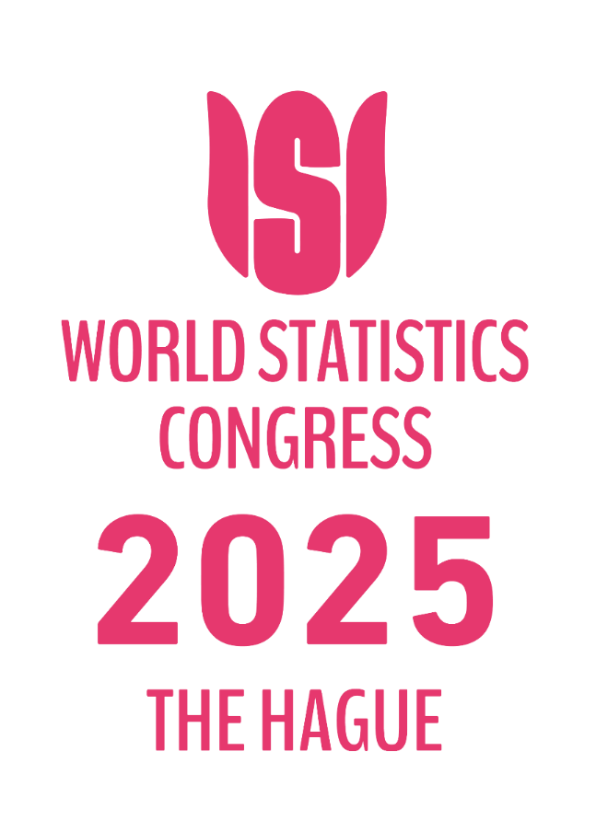

IPS1120
Building forward: experimental work on Distributional Wealth Accounts in Italy
Andrea Neri (Banca d’Italia)
Wednesday 8 October 2025

Slide 2
Background
Long-standing interest in reconciling micro and macro data on household wealth
Financial Accounts since 1964
SHIW: Survey on Household Income and Wealth (IT- HFCS) since 1965
Active participation in the EG-DFA from the beginning
Dissemination of first experimental statistics based on the EG-DFA methodology : January 2024
Only difference: use of administrative information for deposits : A. Neri, M. Spuri, F. Vercelli, Combining survey and administrative data to estimate the distribution of household deposits, 2024.

Slide 3
Thinking ahead: Three Ongoing Workstreams
Reduce reliance on modelling:
Integrate administrative data (cadastral records, credit register)
Expand the wealth concept:
Include currency holdings, pensions
Broaden scope
Extend to income, consumption, non-financial corporations

Slide 4
Leveraging Administrative Records
Improve the design of the survey.
SHIW 2020: new sample design of the SHIW using tax data on personal income (in collaboration with Istat):
Barcaroli, Ilardi, Neri, Tuoto «Optimal sampling design with administrative sources for household finance surveys», Rivista di Statistica Ufficiale, 2, 2021
Understanding and correcting measurement errors.
Neri, Porreca, «Total Bias in Income Surveys when Nonresponse and Measurement Errors are Correlated», Journal of Survey Statistics and Methodology, 2023.
Improving survey information on household debt using granular credit databases
di Salvatore, Mirko Moscatelli, working paper, Banca d’Italia, 2024

Slide 5
Cadastral Data for Housing Wealth
Integrating Cadastral Records into DWA: Preliminary Evidence
Reconciling survey and administrative records to measure housing wealth in Italy,
Neri, Porreca, Zanichelli, Festa, Ghiraldo, Guerrieri forthcoming 2025
Improving estimates on housing wealth with survey and administrative data
Neri, Porreca, Benedetti, Ranalli, forthcoming 2025

Slide 6
Cadastral records

Slide 7
Cadastral records

Slide 8
Measuring currency holdings
Challenges: scarce granular information and benchmark
Benchmark: €200bn currency (≈ €8,000 per household ≈ €3,400 per individual)
Surveys:
ECB SPACE (questions about cash on hand and cash at home)
BDI Household Outlook Survey (question cash at home 2024)

Slide 9
Some descriptive evidence
Average amount of currency in 2022

Slide 10
Imputation of currency holding
Preliminary results
Average imputed value : €670 per household, €1,500 for top 10%
Coverage ratio: ~85% of National Accounts
Currency holding higher for: househols with young persons,rural areas, cash-intensive spenders, secondary home owners, economically sound households; higher savers in deposits
R² 17%

Slide 11
Joint income and wealth distribution
Wages: 2022 coverage: employed ~0.98, positions ~0.95 (aligned with NA) thanks to the new design
Self-employment income: coverage in 2022 is much lower: 0.77 for employed persons* and 0.64 for positions.
Two adjustments: (1) secondary job based on personal income tax data; (2) main source of income based on a subset of reliable respondents and imputed
Capital income: rents
Cadastral information on housing value rented x average return form IT-HFCS data
Financial income :
adjusted stocks from DWA x average return estimated from the HOS survey

Slide 12
Conclusions
Growing pressure for expanding the scope of DWA
The future of DWA lies in blending HFCS, administrative data and other surveys
Combining different sources of information is not straightforward but the benefits outweigh the costs

