Slide 1
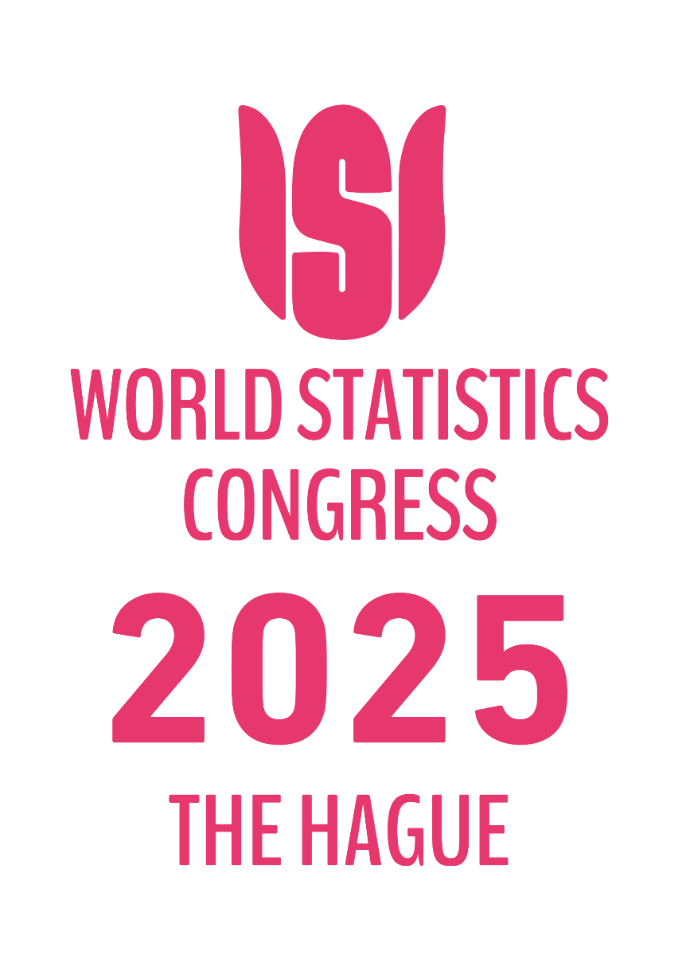

IPS1120
International efforts to measure household distributional information in line with macroeconomic aggregates
Safan van der Gaauw (Statistics Netherlands)
Jorrit Zwijnenburg (OECD)
Wednesday 8 October 2025, 14h00-15h40

Slide 2


How to capture pensions in distributional analyses?
By Safan van der Gaauw (Statistics Netherlands) and Jorrit Zwijnenburg (OECD)
ISI Conference
Session on International efforts to measure household distributional information in line with macroeconomic aggregates
The Hague, October 8, 2025

Slide 3
Contents
Introduction
Recording of pensions in the national accounts
How to deal with pension wealth in distributional analyses?
Practical example of compilation of distributional results on pensions
Conclusions

Slide 4
Introduction

Slide 5
Introduction
Ageing society may have a significant impact on economy, raising important questions, e.g.:
How may it affect sustainability of pension schemes?
How would policy changes affect different groups of households?
There is a need for high-quality distributional information to answer these questions
Household distributional results in line with national accounts may provide important insights
One of the main questions is how to deal with pensions in distributional wealth analyses

Slide 6
Recording of pensions in the national accounts

Slide 7
Types of pension schemes
The main distinction in the System of National Accounts (SNA) is the following:
Social assistance pensions: Foresee in minimum income if other schemes are not sufficient; paid out of general funds
Social insurance pensions: Benefits are conditional on participation in scheme and 1) participation is obligatory, 2) scheme is collective, or 3) employers contribute on behalf of employee.
Social security: Cover entire community (or large sections), are imposed, controlled and financed by government, and require social contributions
Employment-related schemes: Derive from employer-employee relationship, are often part of employment conditions, and require social contributions
Voluntary individual retirement plans: Schemes taken out by individuals on their own initiative (e.g., life insurance)

Slide 8
Recording in the accounts
The recording of pension contributions and benefits depends on the type of scheme:
For social assistance, it concerns benefits only, which are recorded in the non-financial accounts
For social security pensions, they are only recorded in the non-financial accounts
For voluntary individual pensions, they are fully regarded as financial transactions
For employment-related pensions, they are recorded in both, reflecting that they are part of income, but also affect the pension entitlements as accrued by households
Additional complexity: In Europe, all unfunded public employment-related schemes are also excluded from the financial accounts and only recorded in a supplementary table
 | Social assistance | Social security | Employment-related | Voluntary plans
Non-financial accounts | X | X | X
Financial accounts |  |  | X | X

Slide 9
How to deal with pension wealth in distributional analyses?

Slide 10
How to deal with pension wealth in distributions?
There are four options:
Excluding all pension entitlements
Including those entitlements included in the financial accounts
Also including unfunded government schemes
Also including social security schemes

Slide 11
Considerations
Option 1 would give an incomplete picture of inequality in a country and lead to incomparable results across countries if they have different levels of pension provision
Option 2 would include an important part of pension wealth although still only providing a partial picture, still causing incomparable results across countries as well as within a country when government employment-related schemes may be left out (for European countries)
Option 3 would include all employment-related pension wealth which would lead to a wider coverage and improve comparability within a country, but still missing specific part
Option 4 would ensure a comprehensive coverage, leading to fully comparable results across countries, also providing useful insights into the impact of pension reforms
However, not all pension entitlements may have the same (legal) status; it will be important to distinguish between different types of pensions when publishing the data
Another concern is how to derive high-quality results, particularly in case microdata is lacking
Furthermore, NA data on social security entitlements is currently only available every 3 years

Slide 12
Compilation of distributional results for pensions
-
The Dutch experience

Slide 13
Deriving distributional estimates
Compiling distributional wealth statistics
We create a data set covering the full population.
For each individual we have personal characteristics
For each household we have household characteristics
And we have the link household <-> Individuals
We have a unique personal identifyer that is consistent over different micro data sets
To this population we link micro data
Ideally record linked, otherwise by characteristic of the HH/individual
We correct for known errors/omissions and align to NA totals
Micro sources are for wealth, housing value, and pensions claims

Slide 14
Pension Claims Statistics
aims to give an overview of the mandatory (employment related) pension entitlements of the population.
Available for 2015-2022.
Pension entitlements as captured by the presently accumulated gross yearly pension income to be had once of pension age. Excluding those who already receive pension
Annual data, used for the distribution of the opening balance sheets of Employment-related schemes
The Net Present Value of the pension entitlements is calculated using:
The life expectancy of the individual;
The foreseen retirement age;
The interest rate term structure provided by the Central Bank.

Slide 15
Social security pensions
Old age benefit not determined by labor status, rather by years of residence in the Netherlands
For people already in retirement we use Income Statistics micro source
For people still accruing entitlements we assume a yearly increase of 2%-points up to the average benefit upon retirement
The NPV calculation similar to work-related pensions
Voluntary pensions are not explicitly covered, but are approximated by data on life insurance

Slide 16
Pensions – Just how significant?
Pensions represent the lion’s share of financial net worth

Slide 17
Pensions – Just how significant?

Slide 18
Pension and Wealth Inequality

Slide 19
Conclusions

Slide 20
Conclusions
Pension entitlements constitute a large share of household wealth, with majority outside core financial accounts
Several benefits of including all pension entitlements, but important to distinguish between different types of pensions given the different (legal) status
Difficult to obtain good quality micro data on pension entitlements
Literature shows that reliable estimates can be derived by using auxiliary information in line with characteristics of pension schemes (e.g., contributions, benefits, life expectancy, age of person)
Dutch experience shows importance of including pension entitlements in wealth distributions
It also shows how reliable results can be obtained using …
International statistical community should develop further guidance on basis of best practices
This can then be tuned to country-specific circumstances

Slide 21
THANK YOU
For more information please contact: Jorrit.Zwijnenburg@oecd.org
s.vandergaauw@cbs.nl

