Slide 1
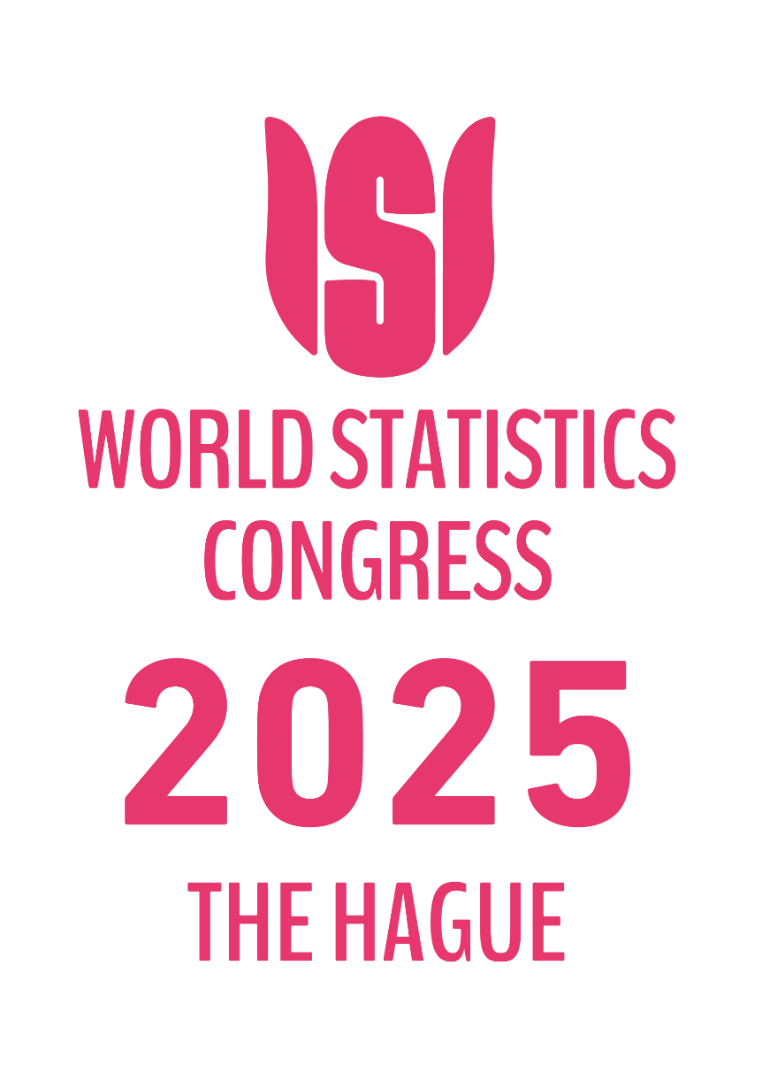

IPS1120
International efforts to measure household distributional information in line with macroeconomic aggregates
Henning Ahnert (ECB)
Nicola Vallo (Eurostat)
Jorrit Zwijnenburg (OECD)
Wednesday 8 October 2025, 14h00-15h40

Slide 2
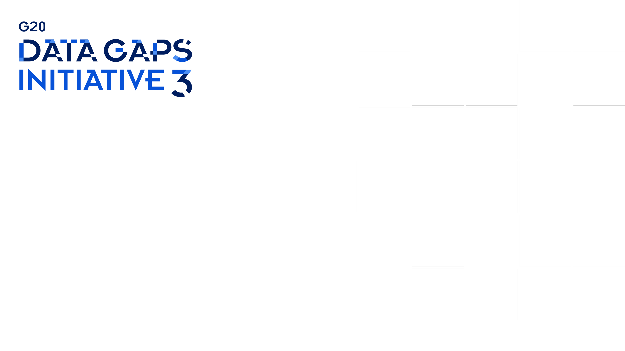

Measuring household distributional results in line with national accounts
ISI Conference
October 8, 2025
Henning Ahnert (ECB)
Nicola Vallo (Eurostat)
Jorrit Zwijnenburg (OECD)

Slide 3
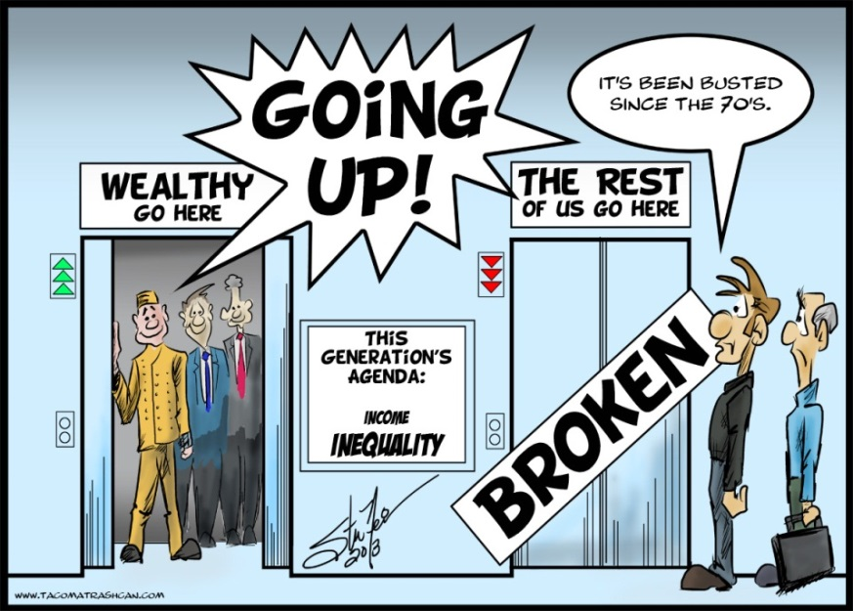
Contents
Introduction
Aim and scope of the work
Overview of the methodology
State of play regarding the work
Some results
Outlook

Slide 4
Introduction

Slide 5
Introduction
Strong policy interest in data on distribution of household income, consumption and wealth
Results provide important insights who is benefiting from economic growth, how various groups contribute to wealth accumulation, and who may be affected by events or policy measures
A lot of information is already available from micro statistics, but increasing emphasis on importance of alignment to macroeconomic aggregates
More comprehensive picture of economic inequality, including elements not covered in micro statistics (e.g., social transfers in kind)
In line with important macroeconomic aggregates, such as GDP, household disposable income and household net worth, providing users with “drill-down” possibilities for key macroeconomic aggregates
Capturing households and transactions that are typically underrepresented in micro data
High degree of international comparability (distributional work included in 2025 SNA)
The ECB, Eurostat and the OECD have been collaborating with member countries to develop templates and methodology for the regular compilation of these results
The G20 Data Gaps Initiative includes two recommendations on household distributional results

Slide 6
Aim and scope of the work

Slide 7
Aim of the work
Develop methodology to produce distributional results for household income, consumption and wealth consistent with national accounts concepts and results using micro data sources
Household groups
MACRO DATA
Macro concepts
-> Totals, growth/stocks
Q2
Q1
Q3
Q5
MICRO DATA
Survey or admin concepts
-> Distribution
Q4

Slide 8
Scope of the work
The unit of analysis is the household
For income and consumption results are equivalized to take into consideration different consumption needs of households of different size and composition
Possible breakdowns by:
Income quintiles/deciles/percentiles
Wealth quintiles/deciles/percentiles
Main source of income
Household type
…
Level of detail depends on available information and quality of the results

Slide 9
Income and consumption concepts
HOUSEHOLD INCOME
HH. CONSUMPTION
Income resources (received):
Self-employment income
Imputed rent from dwellings
Compensation of employees
Property income
Income uses (paid):
Property income
(e.g. interests paid on
loans)
Expenditure:
Food
Clothing
Housing
Health
Education
Transportation…
= Primary Income (PI)
Social benefits in cash
Other transfers
Taxes
Social contributions
Other transfers
= Disposable Income (DI)
= Consumption expenditure (CE)
Social transfers in kind
Social transfers in kind
= Adjusted Disposable Income (ADI)
= Actual Consumption (AC)
Saving = DI - CE = ADI - AC
HH. SAVING

Slide 10
Wealth concepts
HOUSEHOLD ASSETS
HOUSEHOLD LIABILITIES
Non-financial assets
Housing wealth
Non-financial business wealth*
= Non-financial assets (NFA)
Financial assets
Currency**
Deposits
Debt securities
Loans
Equity
Life insurance technical reserves
Pension entitlements**
Other accounts receivable**
(Financial) liabilities
Loans
Other accounts payable**
= Financial assets (FA)
= Financial liabilities (FL)
Net financial worth (NFW) = FA – FL
Net worth (NW) = NFW + NFA
HOUSEHOLD WEALTH
* Not yet included in EG DHW
** Not yet included in EG DHW and EG DWA

Slide 11
Methodology

Slide 12
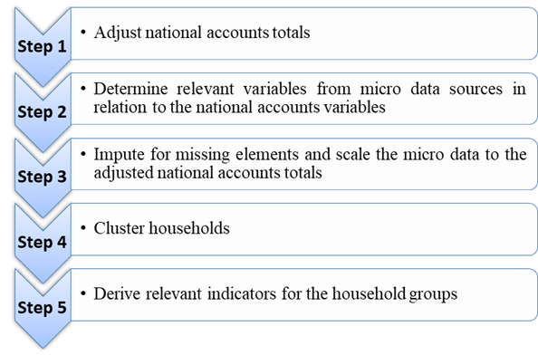
Step-by-step approach

Slide 13
Main challenges
Not all items/elements may be covered in micro data sources
Some items are specific to the system of national accounts (sometimes as imputed items)
Some groups of people may not be covered in micro data sources (e.g. institutional HHs)
Some (sub)items may not be covered by micro data sources (e.g., income from informal activities)
Imputations needed before linking the available micro data to the NA totals
Furthermore, micro aggregates will normally deviate from the macro aggregates
Due to non-response or underreporting in surveys, or different scope of admin data
It is important to bridge these micro-macro gaps in the best possible way
Finally, the lack of availability of micro sources (e.g., household surveys) or access restrictions to admin sources for statistical purposes (e.g., tax sources) pose country-specific challenges

Slide 14
State of play

Slide 15
Distribution of income, consumption and saving
More than a decade ago, Eurostat and the OECD launched an Expert Group on Distributional National Accounts (EG DNA)
The group developed a template and guidelines, and a handbook was published early 2024
Since 2022, Eurostat, the OECD and the ECB are collaborating in the Eurostat Task Force on Households Distributional Accounts (TF HDA)
Results are included in the online databases of Eurostat and the OECD
Data available for 35 countries, i.e., AUS, AUT, BEL, CAN, CRI, CYP, CZE, DEU, DNK, ESP, EST, FIN, FRA, GBR, GRE, HRI, HUN, IRL, ISR, ITA, KOR, LTU, LTV, LUX, MEX, MLT, NLD, NZL, POL, PRT, ROM, SVK, SVN, SWE and USA
A centralized approach has been developed to compile data for countries not engaging in the work
The work continues, focusing on broadening the coverage and improving the quality, granularity and timeliness

Slide 16
Distribution of wealth
In 2016, the ECB launched an Expert Group on Distributional Financial Accounts (EG DFA) to develop distributional wealth results for the euro area and EU countries
Quarterly time series for euro area and 20 EU countries are published by ECB/ESCB (DWA)
ESCB is continuing to further improve results and explore possibilities to extend wealth scope
In 2023, the OECD launched an Expert Group on the Distribution of Household Wealth (EG DHW) to extend this work to non-EU countries, aiming to develop template and guidelines
A first experimental data collection round took place early 2025 based on limited wealth scope
Data available for 24 countries, i.e., AUS, AUT, BEL, CAN, HRV, CYP, DEU, DNK, ESP, EST, FIN, FRA, GRC, HUN, IRL, ITA, LVA, LTU, LUX, MLT, NLD, PRT, SVN, and USA
Data for the European countries are coming from the ECB’s EG DFA
A working paper is forthcoming to highlight results
A centralized approach will be developed to compile results for countries not engaging in the work
The work continues, focusing on broadening the wealth concept, the country coverage and improving the quality, granularity and timeliness

Slide 17
Some results

Slide 18
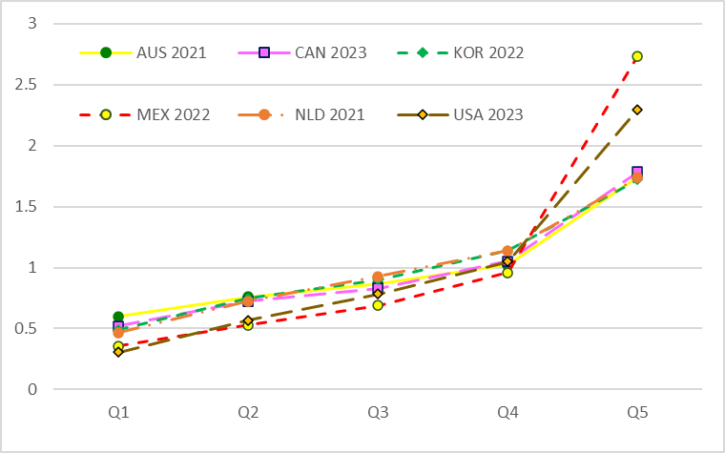
Example: Income, consumption and saving
Adjusted disposable income relative to the average of household sector as a whole

Slide 19
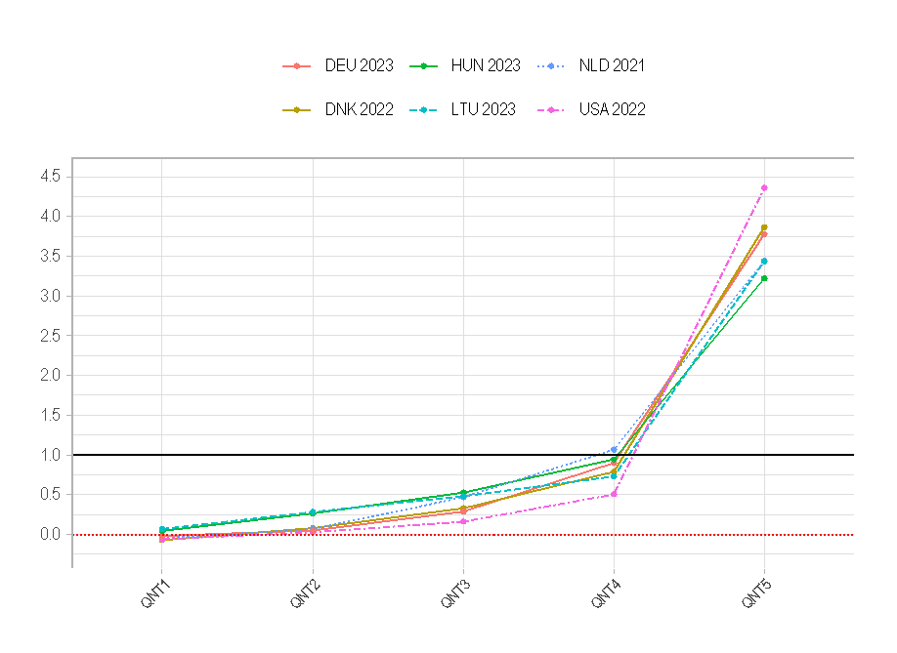
Example: Wealth
Relative position of each household group compared to the average of the household sector as a whole

Slide 20
Example: Wealth
Euro area household net wealth distribution
(left-hand scale: EUR trillions; right-hand scale: percentages)

Slide 21
Next steps

Slide 22
Outlook
Worldwide/OECD:
Further develop methodology, extend coverage, increase granularity and improve timeliness
Implement G20 Data Gaps Initiative Recommendation on distributional accounts on income, consumption and wealth for G20 countries and beyond, including joint ICW distributions
Implement new 2025 SNA guidance on distributional accounts, starting regular data collection
European Union:
Further develop methodology, extend coverage
Preparation of a Best Practices document collecting case studies and national experiences
Implement SNA guidance also in European System of Accounts
Set transmission and dissemination requirements in revised ESA Transmission Programme and ECB Guideline on Financial Accounts with the objective to fully implement the distributional accounts by the turn of the decade

Slide 23
Thank you very much for your attention!
For more information please contact:
Henning.Ahnert@ecb.europa.eu
Nicola.Vallo@ec.europa.eu
Jorrit.Zwijnenburg@oecd.org

