Slide 1
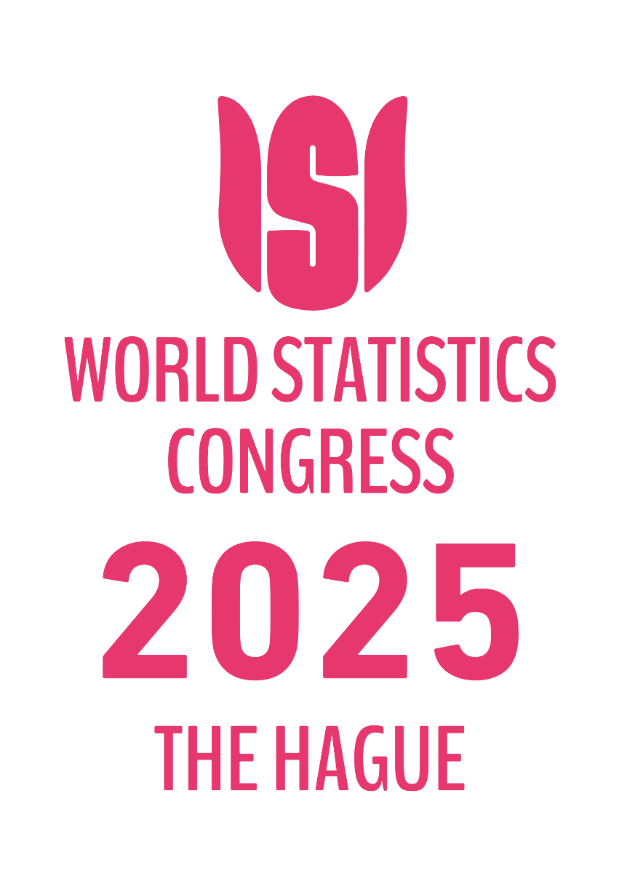


IPS1120
HOUSEHOLD DISTRIBUTIONAL RESULTS ON INCOME, CONSUMTION AND SAVING IN ARMENIA
Tigran Baghdasaryan (Head of Real Sector Statistics Division)
Kristine Karapetyan (Economist-Statistcian)
Wednesday 8 October 2025, 14h00-15h40
The views expressed herein are those of the author(s) and do not necessarily represent the views of Central Bank of Armenia, its Executive Board, or CBA management.

Slide 2
Content
Main objectives
Data sources
Methodology
Results
Results – Income
Results – Consumption & Saving
Main challenges
Next steps
65th ISI World Statistics Congress – 5-9 October 2025, the Hague, the Netherlands / 2

Slide 3
Main Objectives
Harmonisation of national accounts and well-being statistics in Armenia
Better understanding the difference between micro and macro aggregates
65th ISI World Statistics Congress – 5-9 October 2025, the Hague, the Netherlands / 3

Slide 4
Data Sources
Household’s Integrated Living Conditions Survey (HILCS)
Sectoral accounts / HH sector
Other sources
65th ISI World Statistics Congress – 5-9 October 2025, the Hague, the Netherlands / 4

Slide 5
Data Sources
HILCS
Purposes
Estimation the well-being indicators and
HH expenditure basket of CPI.
Main characteristics
Target population – all private households (residents) / not individuals, absence data about institutional households
Type of information - Income, non-wage income, transfers, employment, durable goods, education, health, housing, agricultural activity, food production, consumption, and etc.
65th ISI World Statistics Congress – 5-9 October 2025, the Hague, the Netherlands / 5

Slide 6
Data Sources
HH sector
National concept
All private households, exclusion data about institutional households
Other sources
Income statement of financial organisations
State budget - STIK
Central Bank publications - the change in pension entitlements
65th ISI World Statistics Congress – 5-9 October 2025, the Hague, the Netherlands / 6

Slide 7
Methodology
Based on EG-DNA concept
Step 1 - Adjustments to NA totals
Step 2 - Determining relevant micro data sources
Step 3 - Imputation for missing items and alignment
Step 4 - Cluster households
Step 5 - Derivation of indicators to present the distributional results
65th ISI World Statistics Congress – 5-9 October 2025, the Hague, the Netherlands / 7

Slide 8
Results – Income Table 1. Income items in macro and micro levels in 2021, bln. AMD
 | Indicators | Macro | Micro | Macro - estimated
B2Rg+B3Rg | Gross operating surplus and mixed income | 1,371.84 | N/A | 1,371.84
B2Rg | Gross operating surplus | N/A | N/A | 361.97
B2R1g | Owner occupied dwellings | N/A | N/A | 361.97
B3Rg | Gross mixed income - total | 1,371.84 | N/A | 1,009.87
D1R | Compensation of employees | 2,548.78 | N/A | 2,548.78
D11R | Wages and salaries | N/A | 1,358.41 | N/A
D4N | Net property income received / Net property income | -98.46 | N/A | -98.46
D4R | Property income received | 152.85 | 11.84 | 152.85
D41R | Interest received | N/A | N/A | 86.74
D4P | Property income paid | 251.31 | N/A | 251.31
D41P | Interest paid | N/A | N/A | 189.37
B5g | Balance of primary incomes | 3,822.16 | N/A | 3,822.16
D62R | Social benefits other than STiK received | N/A | 410.75 | N/A
D6211R+D6221R | Pension benefits | N/A | 289.93 | N/A
D6212R+D6222R | Non-pension benefits | N/A | 120.82 | N/A
D75N | Net miscellaneous current transfers | N/A | - | 445.59
D75R | Miscellaneous current transfers received | N/A | 243.40 | 574.42
D75P | Miscellaneous current transfers paid | N/A | N/A | 128.83
D75x | of which transfers between resident households (2008 SNA 8.133) | N/A | 45.85 | N/A
B6g | Disposable income | 4,326.18 | N/A | 4,326.18
D63R | STiK | N/A | N/A | 285.79
D63R1 | Education | N/A | N/A | 134.51
D63R2 | Health | N/A | N/A | 151.27
B7g | Adjusted disposable income | 4,326.18 | N/A | 4,611.97
Own estimation
Changes after estimation
65th ISI World Statistics Congress – 5-9 October 2025, the Hague, the Netherlands / 8

Slide 9
Results – Income
Imputations and alignment related to Wages and Salaries
Step 1. Imputations of missing values
Step 2. Estimation of Income tax, Social contribution by employee, Stamp duty
Step 3. Alignment with national accounts total Compensation of employees (Wages and salaries)
Table 2. Wages and salaries in micro and macro levels (2021), bln. AMD
1.3% can be estimation bias and /or measurement bias and allocated to quantile five
Items | Micro | Micro - after imputations and alignment | Macro | Micro/Macro
Compensation of employees (Wages and salaries) |  | 2,516.1 | 2,548.8 | 98.7
Net wages and salaries | 1,358.4 | 1,883.4
Income tax |  | 504.5
Social contribution by employee |  | 83.1
Stamp duty |  | 45.0
65th ISI World Statistics Congress – 5-9 October 2025, the Hague, the Netherlands / 9

Slide 10
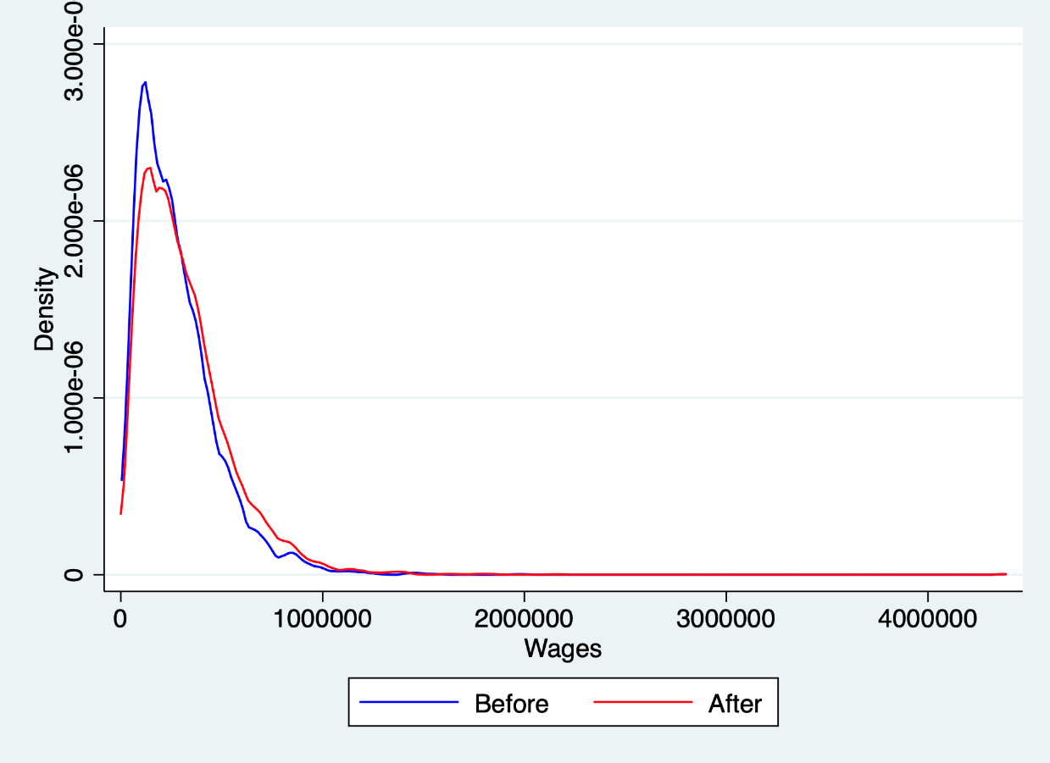
Results – Income
Figure 1. Distribution of wages and salaries before and after imputation and alignment, 2021
65th ISI World Statistics Congress – 5-9 October 2025, the Hague, the Netherlands / 10

Slide 11
Results – Income
65th ISI World Statistics Congress – 5-9 October 2025, the Hague, the Netherlands / 11

Slide 12
Results – Income
65th ISI World Statistics Congress – 5-9 October 2025, the Hague, the Netherlands / 12

Slide 13
Results – Income
65th ISI World Statistics Congress – 5-9 October 2025, the Hague, the Netherlands / 13

Slide 14
Results – Income
65th ISI World Statistics Congress – 5-9 October 2025, the Hague, the Netherlands / 14

Slide 15
Results – Income
65th ISI World Statistics Congress – 5-9 October 2025, the Hague, the Netherlands / 15

Slide 16
Results – Income
65th ISI World Statistics Congress – 5-9 October 2025, the Hague, the Netherlands / 16

Slide 17
Results – Income
65th ISI World Statistics Congress – 5-9 October 2025, the Hague, the Netherlands / 17

Slide 18
Results – Income
65th ISI World Statistics Congress – 5-9 October 2025, the Hague, the Netherlands / 18

Slide 19
Results – Income
65th ISI World Statistics Congress – 5-9 October 2025, the Hague, the Netherlands / 18

Slide 20
Results – Consumption & Saving Table 3. Consumptions items in macro and micro levels in 2021, mln. USD
 | Indicators | Macro | Micro | Micro / Macro
CP010 | Food and non-alcoholic beverages | 2,280.30 | 806.03 | 35.35
CP020 | Alcoholic beverages, tobacco and narcotics | 244.07 | 83.66 | 34.28
CP030 | Clothing and footwear | 188.56 | 53.58 | 28.42
CP040 | Housing, water, electricity, gas and other fuels | 757.70 | N/A | N/A
CP050 | Furnishings, households equipment and routine maintenance of the house | 104.39 | 50.96 | 48.82
CP060 | Health | 291.43 | 88.60 | 30.40
CP070 | Transport | 310.41 | 33.08 | 10.66
CP080 | Communications | 176.38 | 51.82 | 29.38
CP090 | Recreation and culture | 117.17 | N/A | N/A
CP100 | Education | 61.95 | 35.39 | 57.13
CP110 | Restaurants and hotels | 123.68 | 31.19 | 25.22
CP120 | Miscellaneous goods and services | 138.42 | 62.92 | 45.45
P31DC | Final domestic consumption expenditure | 4,794.46 | N/A | N/A
P33-P34 | Adj. for expenditures by resident HH abroad minus expenditures by non-resident HH on the territory | 150.65 | N/A | N/A
P33 | Final consumption expenditure of resident households abroad | 409.78 | N/A | N/A
P34 | Final consumption expenditure of non-resident households on the territory | 259.13 | N/A | N/A
P31NC | Final national consumption expenditure | 4,945.12 | 1,330.32 | 26.90
D63R | STiK | 285.79 | N/A | N/A
P4 | Actual final consumption | 5,230.90 | N/A | N/A
B7 | Adjusted disposable income | 4,973.94 | N/A | N/A
D8R | Adjustment for the change in pension entitlements | 101.66 | N/A | N/A
B8 | Gross Saving | - 155.31 | N/A | N/A
P51c | Consumption of fixed capital | 329.05 | N/A | N/A
B8n | Net Saving | - 484.36 | N/A | N/A
Own estimation
Changes after estimation
65th ISI World Statistics Congress – 5-9 October 2025, the Hague, the Netherlands / 19

Slide 21
Main challenges
Absence of information about institutional HH
Missing data income and consumption sides both macro and micro levels
Macro – micro gaps are large even the data are excising in macro and micro levels
65th ISI World Statistics Congress – 5-9 October 2025, the Hague, the Netherlands / 20

Slide 22
Next steps
To find other statistical and administrative microdata sources.
Enhancing Armstat survey questioners.
Applying the methods based on EG DNA recommendation for imputation missing data for other items of income side and consumption side as well as.
Aligning micro data of other part of income with national accounts totals and consumption side as well as.
Clustering households into household groups.
65th ISI World Statistics Congress – 5-9 October 2025, the Hague, the Netherlands / 21

Slide 23
Thank you very much for attention!

